Slide 1
RDF Data Clustering Framework
Team Members Information
400C
Under the Supervision of
Dr. Mohammad Rezwanul Huq
Associate Professor
Department of Computer Science and Engineering
East West University
Dhaka, Bangladesh
Prinom Mojumder
2021-2-60-098
Suraiya Nusrat Tanha
2021-2-60-030
Nur Nahar Mim
2021-1-60-091
Tasnim Israk Synthia
2021-2-60-097

Slide 2
Overthought
Motivation
Our Research
Result Analysis
Our Content
Discussion
Research Question
Related Work
Future Work
Risk assessment
Dataset
Conclusion
Methodology
1

Slide 3
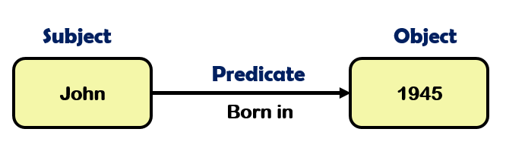
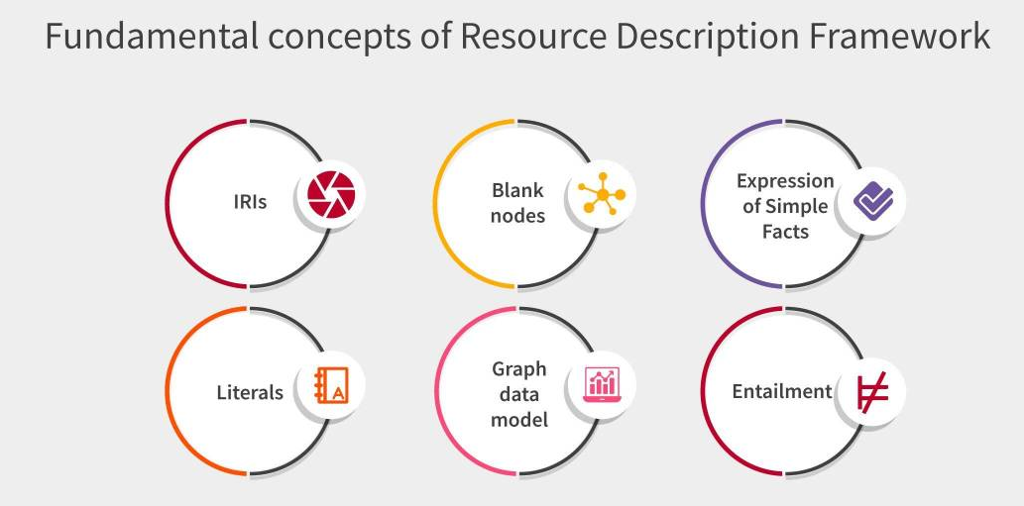
What is RDF ?
RDF (Resource Description Framework) structures data using triples (Subject-Predicate-Object).
Core of the Semantic Web, enabling linked and interoperable data.
Used in knowledge graphs, semantic search, and linked data.
2

Slide 4
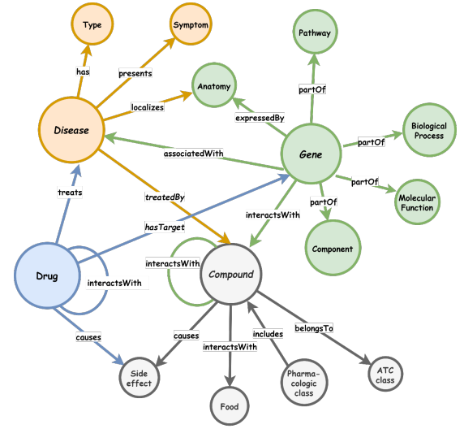
What is Knowledge Graph?
A structured representation of knowledge using entities and relationships.
Connects data through semantic links, improving understanding.
Powered by RDF, OWL, and SPARQL for integration and querying.
Used in search engines, chatbots, and recommendation systems.
3

Slide 5
Motivation
Growing Need for RDF Clustering: RDF data is expanding rapidly, requiring better organization and analysis.
Semantic Complexity Challenge: Traditional clustering struggles with RDF rich contextual meanings.
Advancements in Embeddings: Techniques like RDF2Vec, Word2Vec, and BERT offer new opportunities for better clustering.
Real-World Applications: Improved RDF clustering benefits semantic search, knowledge graph enrichment, and ontology alignment.
Enhancing Accuracy & Interpretability: Transforming RDF data into meaningful vectors leads to more efficient and insightful clustering.
4

Slide 6
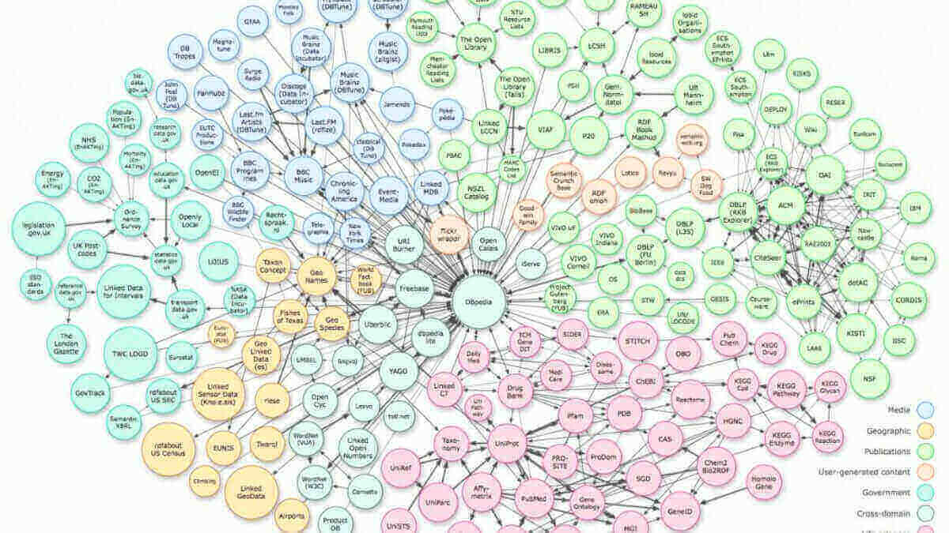
Our Research
Generate sequences from RDF data to capture entity relationships.
Convert sequences into numerical vectors using RDF2Vec and BERT.
Apply clustering algorithms to identify hidden patterns.
Enhance semantic understanding by leveraging RDF structure.
Improve clustering accuracy with contextual and semantic insights.
5

Slide 7

Research questions
This research seeks to answer the following questions:
How do different embedding techniques affect the clustering quality of RDF data?
Which clustering algorithm performs best for RDF data based on evaluation metrics such as ARI, NMI, and Silhouette Score?
Can embedding-based clustering improve the interpretability and retrieval efficiency of RDF datasets and find the semantic relationship?
6

Slide 8

Related Work
Algorithm | Key Findings (Accuracy & Performance) | Limitations
Graph Walks + Word2Vec (CBOW, Skip-Gram) | 82.5% accuracy, enabled machine learning on RDF | Graph walks loss structure, high computational cost
K-means on Set of Walks + TF-IDF + Doc2Vec | 97% purity, 90%+ F-measure, improved RDF clustering | Overlapping clusters, needs further optimization
Word2Vec/Doc2Vec + k-means | Achieved highest purity (96.99%) and F-measure | Needs better optimization techniques
BERT + Context Graph (KG) | Outperforms and improves interpretability | No granular answers, BERT ambiguity issues
7

Slide 9
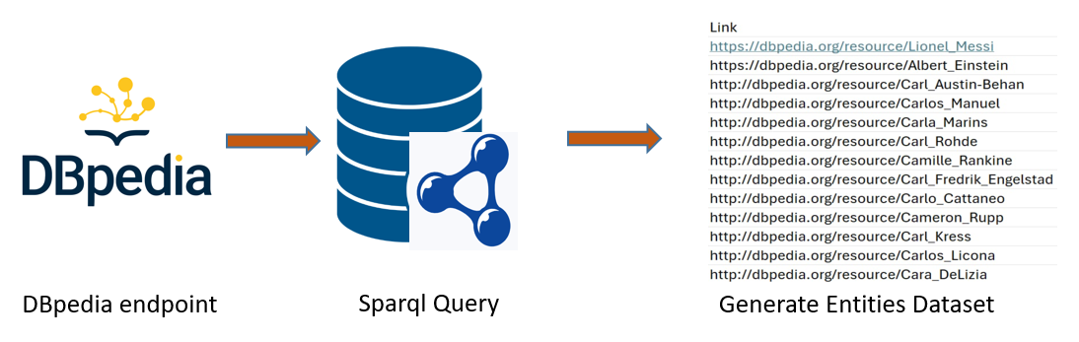
Dataset Constracting
Data Collection.
Data Preprocessing
Embedding Generation
Efforts to Create a Custom Dataset
8

Slide 10
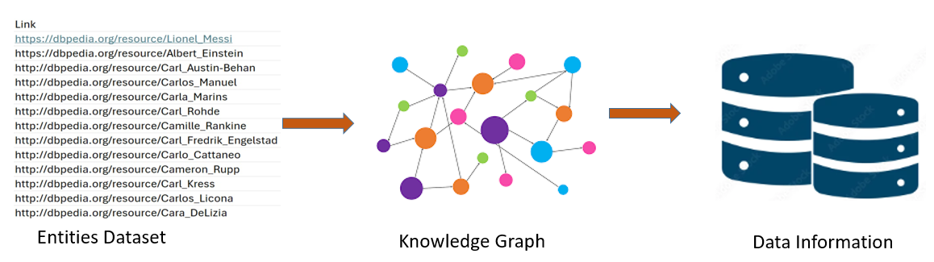

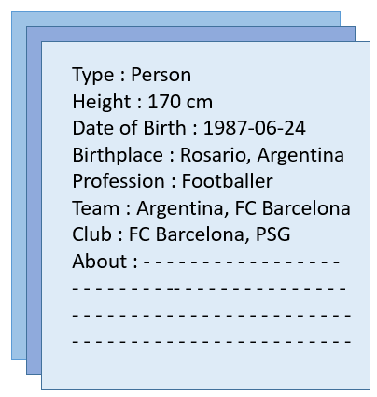
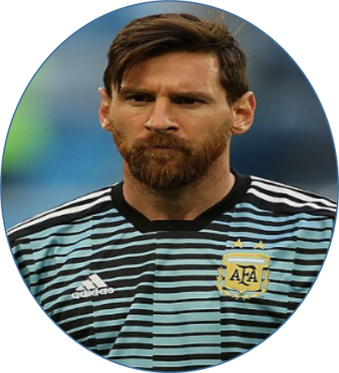
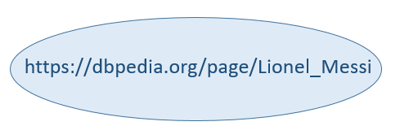
( Literals/ Entities information )
Link
9

Slide 11
Methodology
Approach 1
Extract entities from DBpedia using SPARQL queries.
Build a new knowledge graph.
Analyze entity relationships through embeddings, clustering, and visualization.
Approach 2
Utilize an existing knowledge graph.
Extract entity relationships.
Apply embeddings, clustering, and visualization for structured analysis.
10

Slide 12

Overview
SPARQL query for the Entities from the existing Knowledge Graph (DBpedia)
Get sequence/
entities information
Apply Elbow (to find the optimal number of clusters)
Make embedding using BERT
Apply PCA (for dimension reduction)
Apply clustering algorithm (K-means, GMM, Agglomerative)
Generate Entities By DBpedia Endpoint & SPARQL Query
Make embedding (Text to Vector) using Word2Vec
Again apply PCA (for visualization)
Build Knowledge Graph for those Entities
Generate sequence/entities information using Random Walk
Generate result Matrix
11

Slide 13
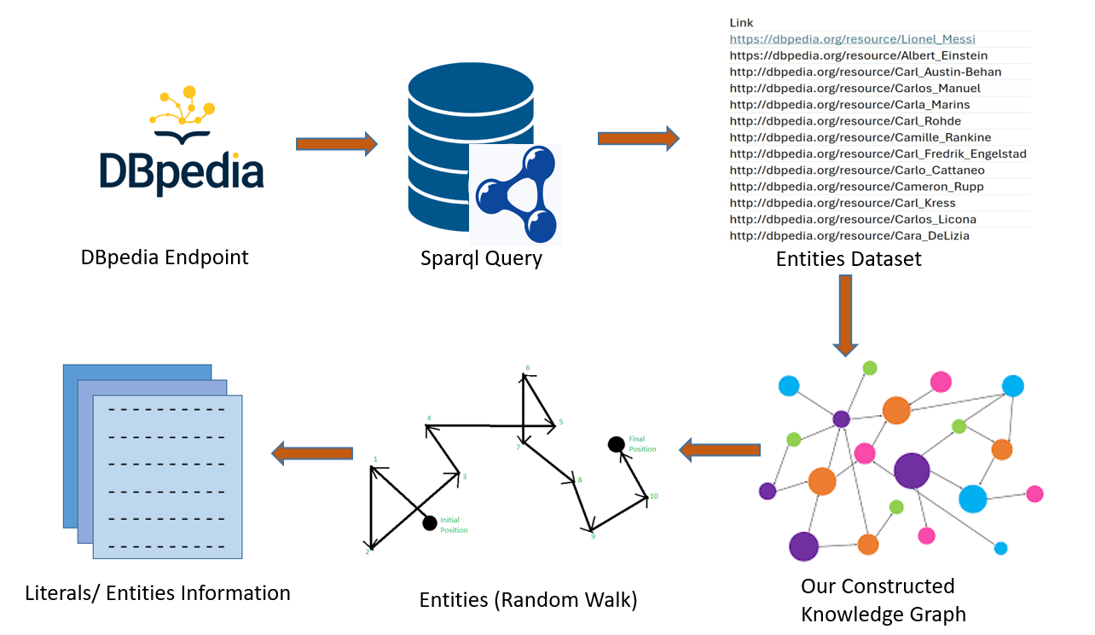
01
Approach 1
Step
12

Slide 14
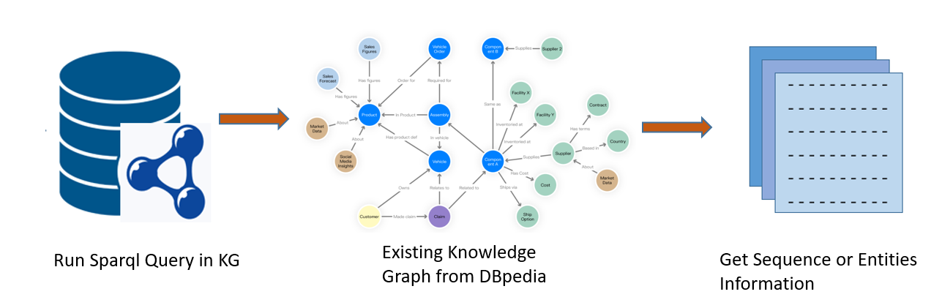
Approach 2
01
Step
13

Slide 15
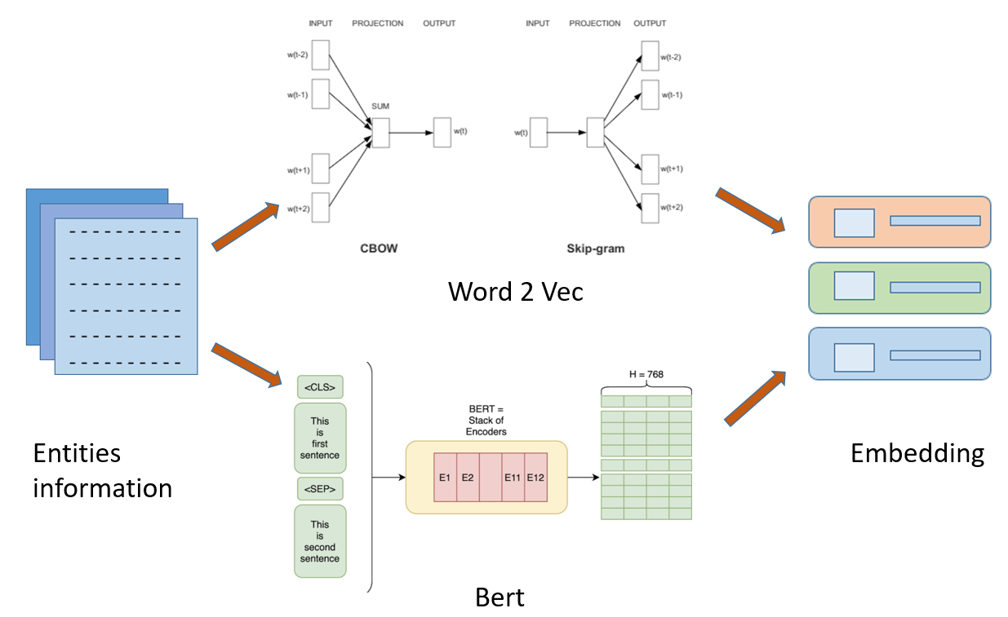
02
Step
14

Slide 16
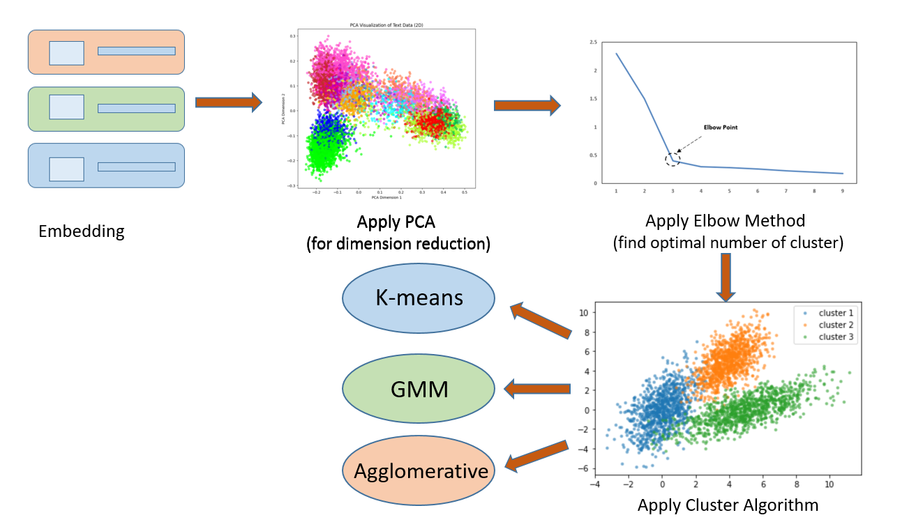
03
Step
15

Slide 17
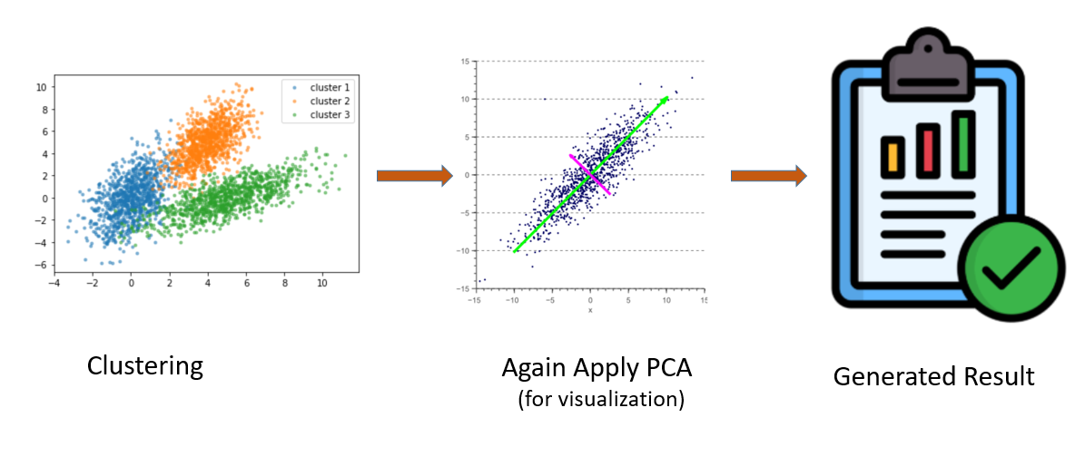
04
Step
16

Slide 18
Result Analysis
17

Slide 19
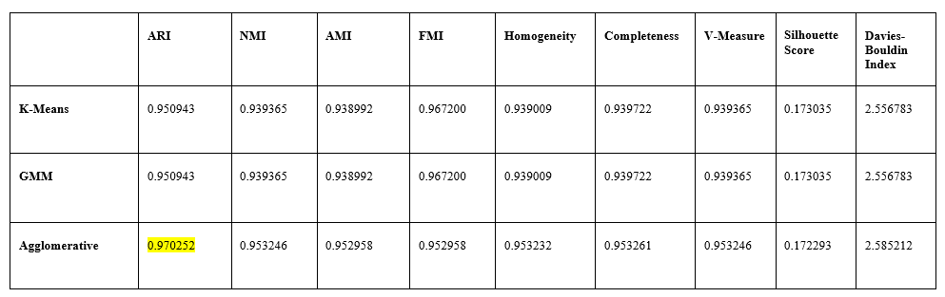
Result Metrics of Clustering Algos (Existing KG)
BERT
18

Slide 20
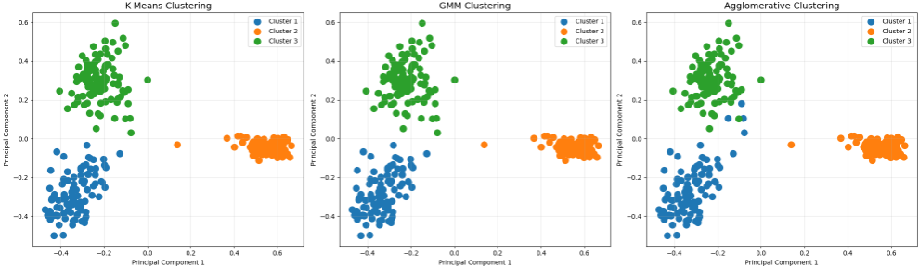
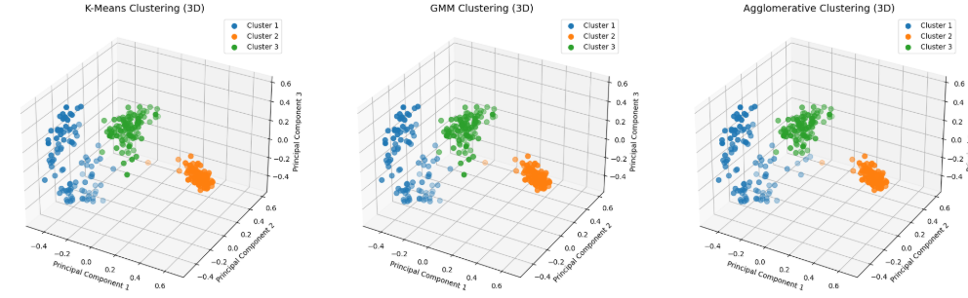
Visualization of Clustering Algos (Existing KG)
BERT
2D ->
3D ->
19

Slide 21
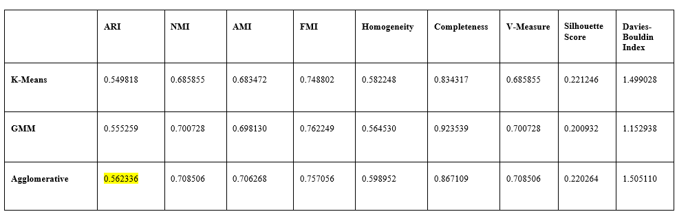
Result Metrics of Clustering Algos (Existing KG)
Word2Vec
20

Slide 22
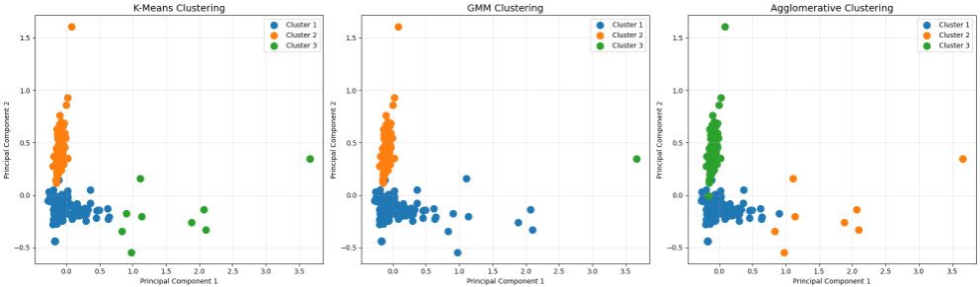
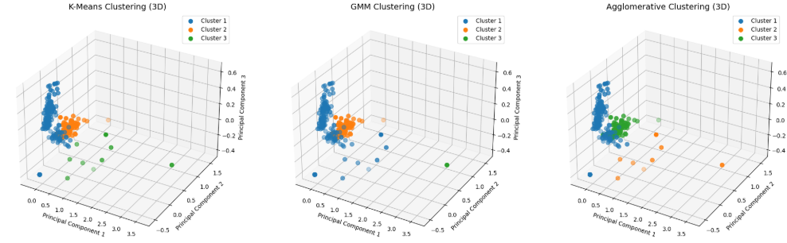
Visualization of Clustering Algos (Existing KG)
Word2Vec
2D ->
3D ->
21

Slide 23
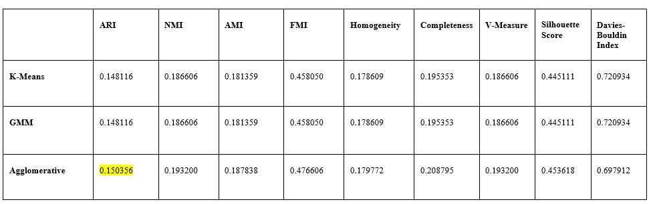
Result Metrics of Clustering Algos (Constructed KG)
Word2Vec
22

Slide 24
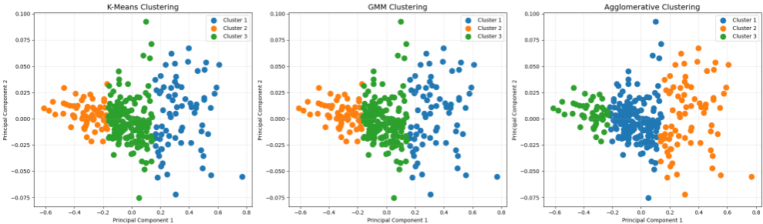
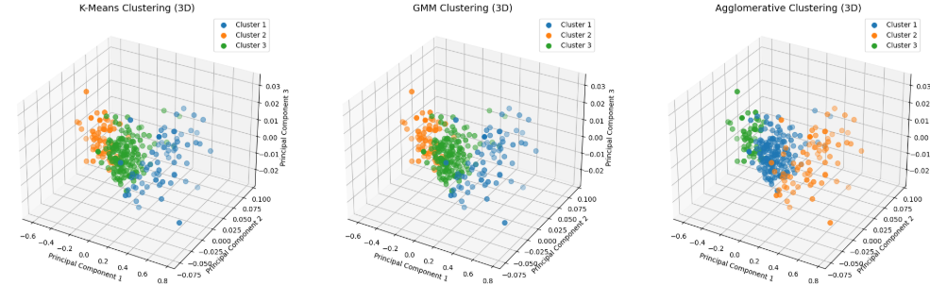
Visualization of Clustering Algos (Constructed KG)
Word2Vec
2D ->
3D ->
23

Slide 25
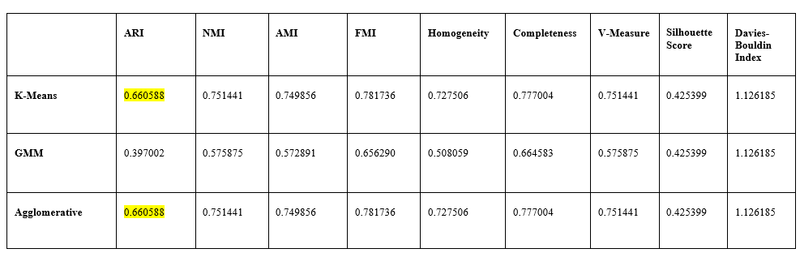
Result Metrics of Clustering Algos (Constructed KG)
BERT
24

Slide 26
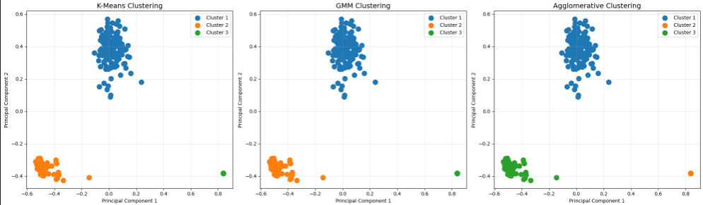
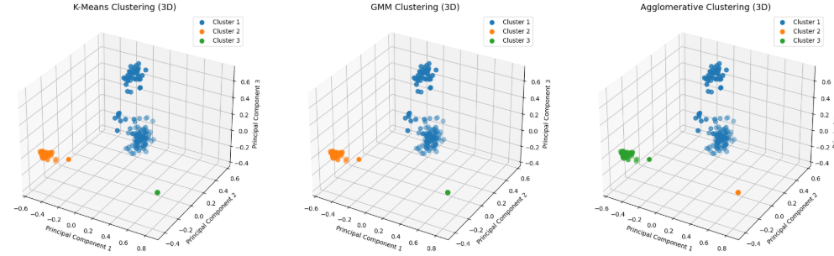
Visualization of Clustering Algos (Constructed KG)
BERT
2D ->
3D ->
25

Slide 27
Comparison between Existing KG & Constructed KG
Fig 1: Existing KG - K Means(BERT)
Fig 3: Constructed KG - K Means(BERT)
Fig 2: Existing KG - K Means(Word2Vec)
Fig 4: Constructed KG - K Means(Word2Vec)
26

Slide 28
Video Of 3D Visualization for Existing KG with BERT
Persons are marked with green boxes
Plants are marked with Red circle
Devices are marked with Blue rectangle
27

Slide 29
Application
28

Slide 30
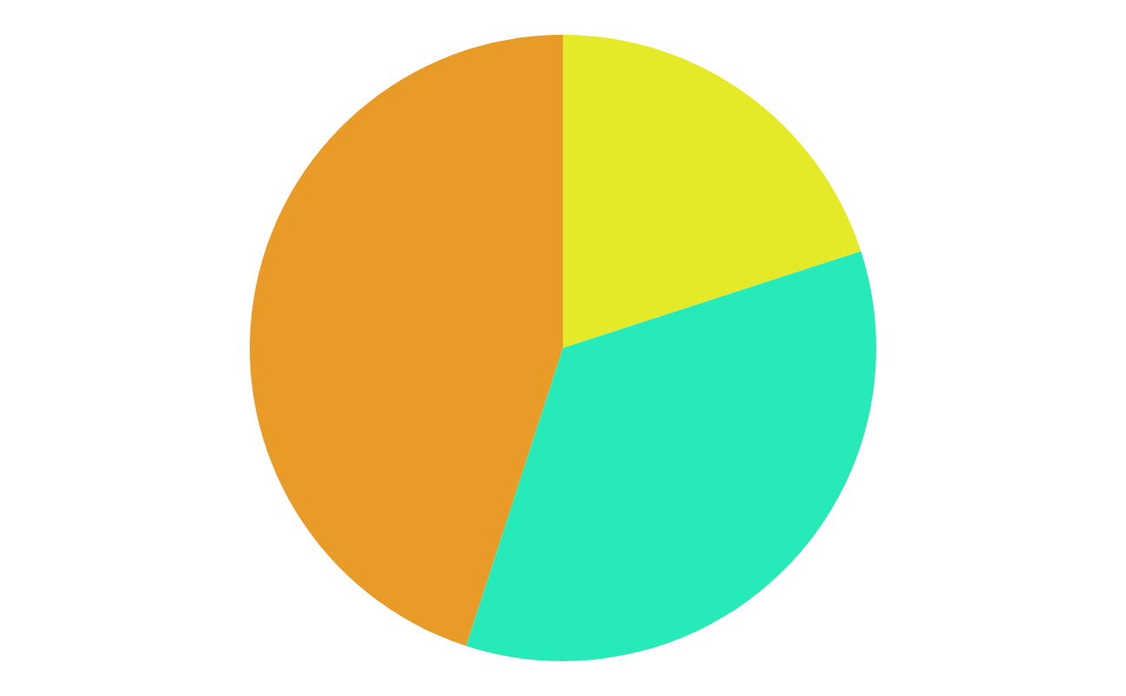
Discussion
&
Conclusion
29

Slide 31
Comparison with current methods
Feature | Previous Works | Our Research paper (RDF Data Clustering Framework)
Embedding Techniques | Used Word2Vec, Doc2Vec, or RDF2Vec individually | Two distinct approaches: Approach 1- RDF2Vec,where Word2Vec is employed for embedding, Approach 2- BERT for diverse semantic analysis
Clustering Methods | Limited to K-Means, Hierarchical Clustering | Uses K-Means, GMM, and Agglomerative Clustering for better adaptability
Dataset Scope | Small datasets (AIFB, BGS, DBpedia subsets) | Uses DBpedia, Wikidata, and custom datasets for broader entity coverage
Context Understanding | Lacked deep semantic understanding | Approach 1 captures graph structures (RDF2Vec), Approach 2 captures deep contextual relationships (BERT)
Dimensionality Reduction | Rarely applied or limited to simple methods | Uses PCA to optimize clustering performance and reduce noise
30

Slide 32
Feature | Previous Works | Our Research paper (RDF Data Clustering Framework)
Evaluation Metrics | Accuracy, Purity | ARI, NMI, Silhouette Score for a more comprehensive evaluation
Computational Efficiency | Some methods computationally expensive | Balances embedding complexity and clustering for scalability
Real-world Applicability | Mostly theoretical, limited practical use | Optimized for real-world knowledge graph enrichment and semantic search
Flexibility | Focused on specific datasets or methods | Two complementary approaches, enabling different insights based on dataset characteristics
Innovation | Improved RDF graph clustering but with limitations | First to integrate RDF2Vec, Word2Vec, and BERT into two structured approaches, enhancing retrieval and interpretability
31

Slide 33
Future Work & Conclusion
Optimize embedding techniques for better scalability and efficiency.
Extend the framework to support larger and more complex RDF datasets.
Explore deep learning-based clustering methods for enhanced performance.
Apply the framework to real-world linked data applications, such as knowledge graph completion.
Developed an RDF Data Clustering Framework integrating embeddings and clustering techniques.
Improved RDF data organization and retrieval through embedding-based clustering.
Demonstrated the effectiveness of different clustering algorithms on RDF data.
Showcased the impact of embedding techniques like BERT and Word2Vec in semantic analysis.
Highlighted the advantages of constructing a new knowledge graph compared to using an existing one.
32

Slide 34
Thank You

